Slide 1
Capstone project : 02
You are hired as a DevOps engineer for Analytics Pvt Ltd. This company is a product based organization which uses Docker for their containerization needs within the company. The final product received a lot of traction in the first few weeks of launch. Now with the increasing demand, the organization needs to have a platform for automating deployment, scaling, and operations of application containers across clusters of hosts, As a DevOps engineer, you need implement a DevOps life cycle, such that all the requirements are implemented without any change in the Docker containers in the testing environment. Up until now, this organization used to follow a monolithic architecture with just 2 developers. The product is present on
https://github.com/hshar/website.git
Following are the specifications of life-cycle:
1. Git workflow should be implemented. Since the company follows monolithic architecture of Development you need to take care of version control. The release should happen only on 25th of every month.
2. Code build should be triggered once the commits are made in the master Branch.
3. The code should be containerized with the help of the Docker file, The Dockerfile should be built every time if there is a push to Git-Hub. Createa custom Docker image using a Dockerfile.
4. As per the requirement in the production server, you need to use the Kubernetes cluster and the containerized code from Docker hub should be deployed with 2 replicas. Create a NodePort service and configure the same for port 30008.
5. Create a Jenkins pipeline script to accomplish the above task.
6. For configuration management of the infrastructure, you need to deploy the configuration on the servers to install necessary software and configurations.
7. Using Terraform accomplish the task of infrastructure creation in the AWS cloud provider.
Software’s to be installed on the respective instances
Terraform-M : Jenkins, Java.
Kube-M : Docker, Kubernetes.
Kube-S1 : Java, Docker, Kubernetes

Slide 2
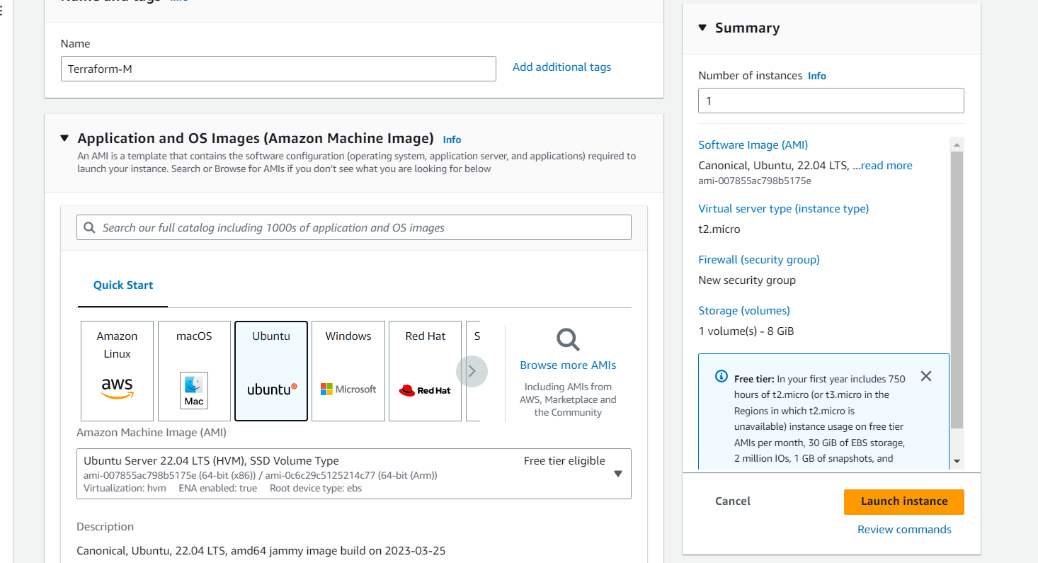
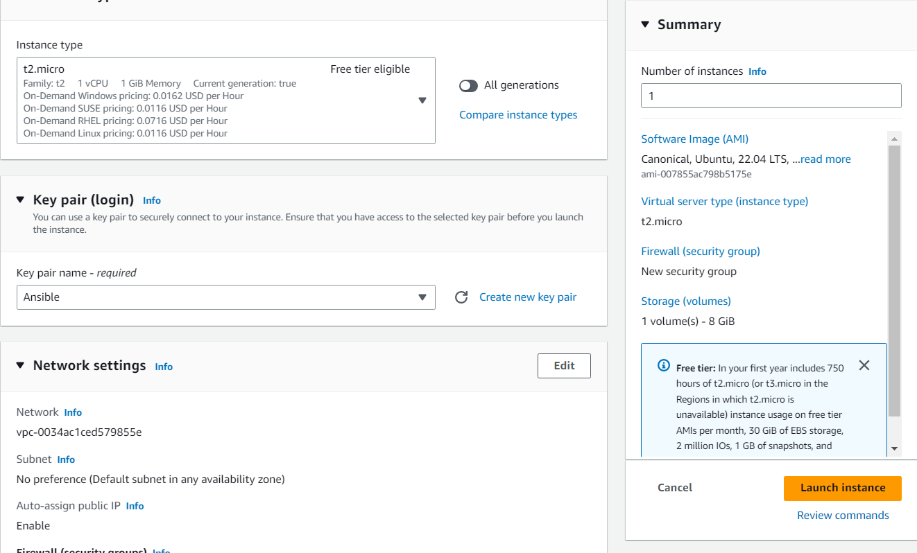
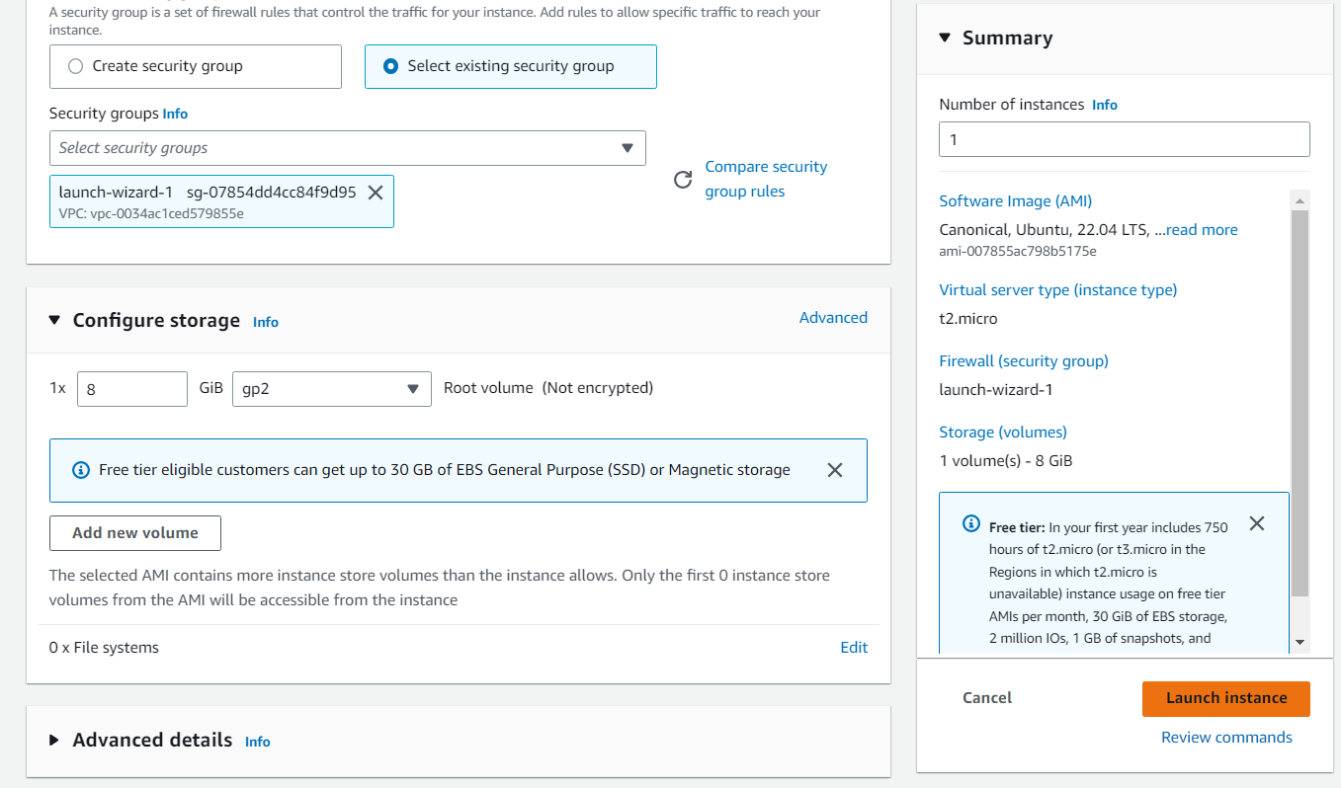
Step : 01
Create the master instance for installation of terraform and Jenkins on it.

Slide 3
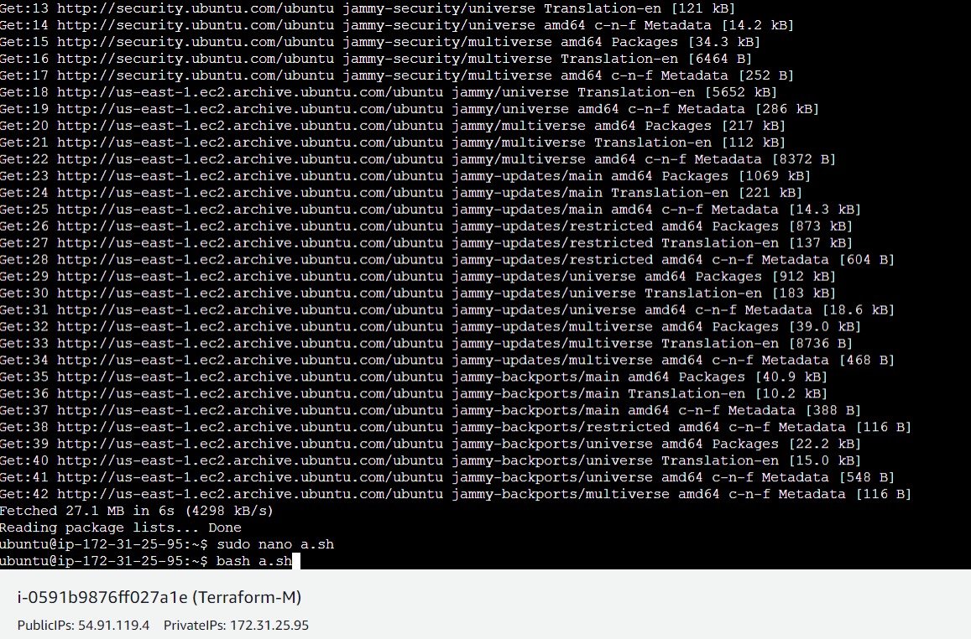
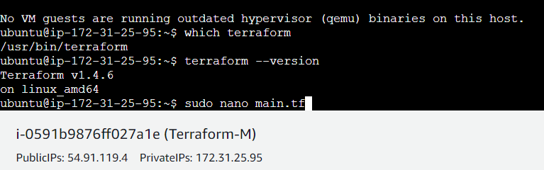
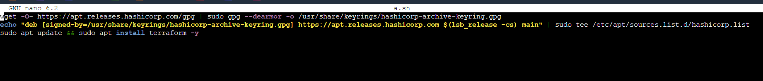
Step : 02
After creating the instance we have update the instance using the command sudo apt-get update.
We have to create a file and have to copy paste the installation commands from terraform official documentation. And Then bash the file it will install the terraform.

Slide 4
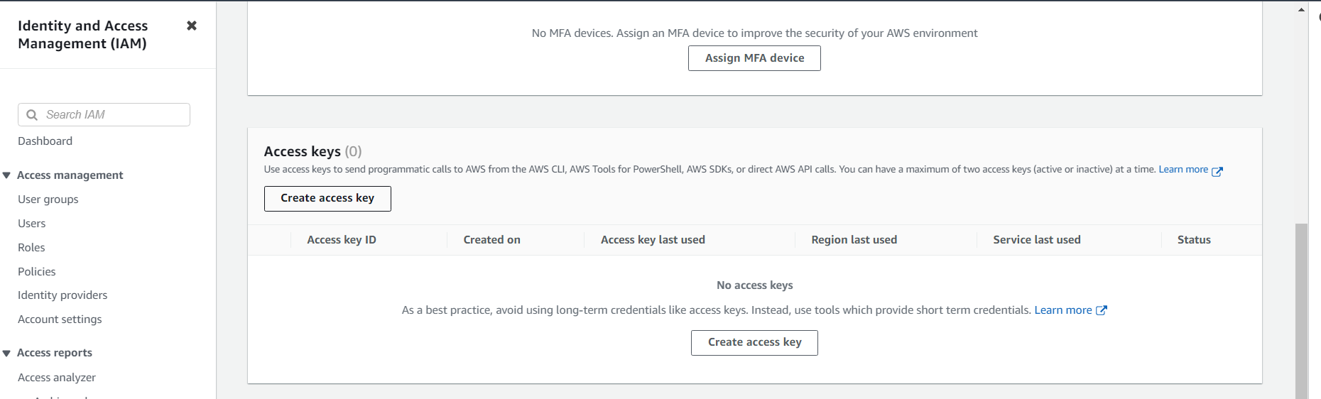
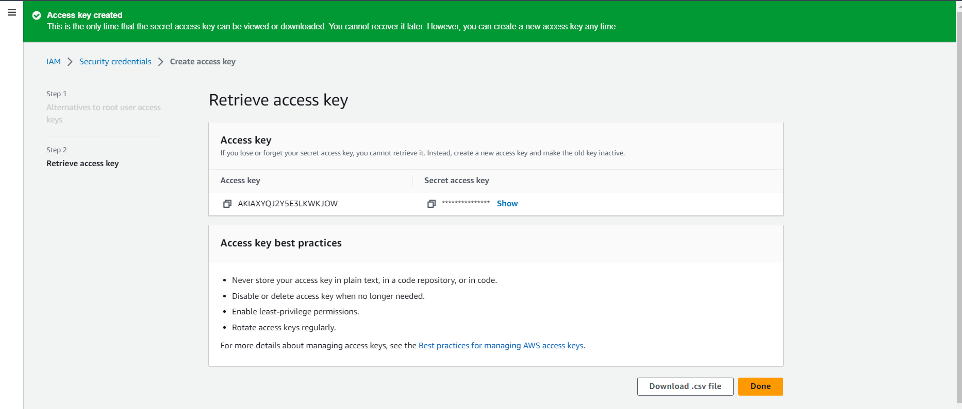
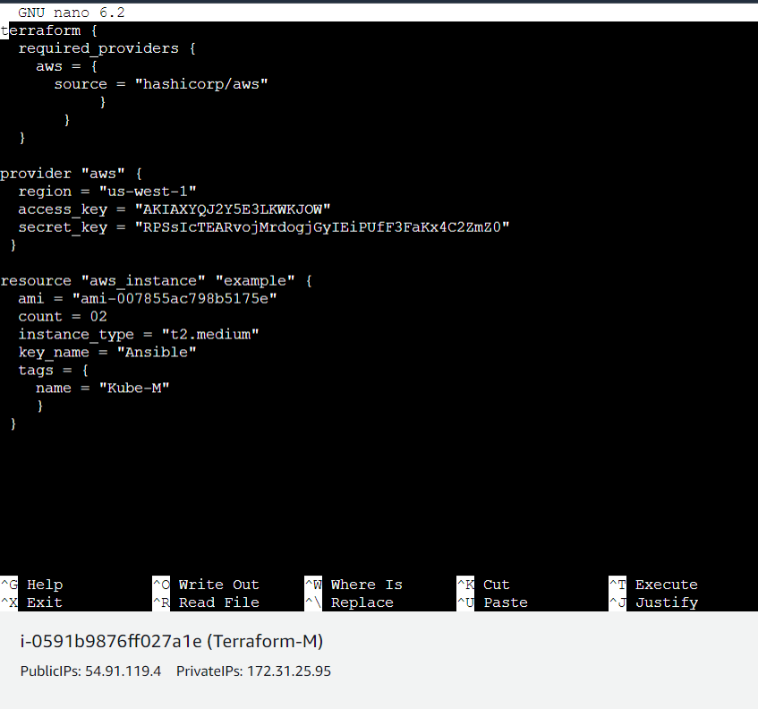
.
Step : 03
After installation of the terraform on the instance, Create the main.tf file for creating the instance on AWS using main.tf file.
We have to create Access key for giving access to AWS account through main.tf file.

Slide 5
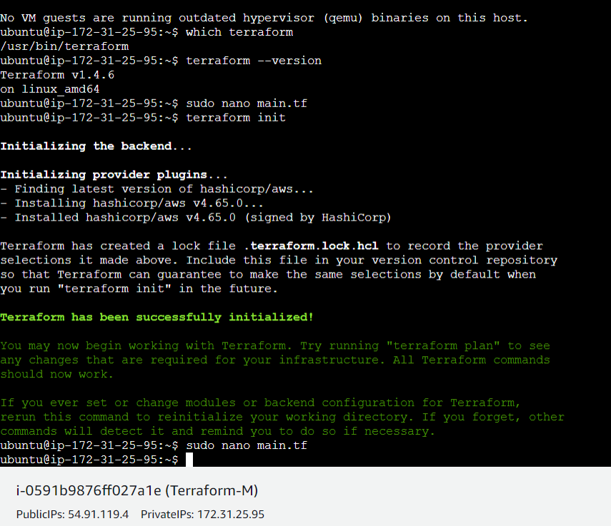
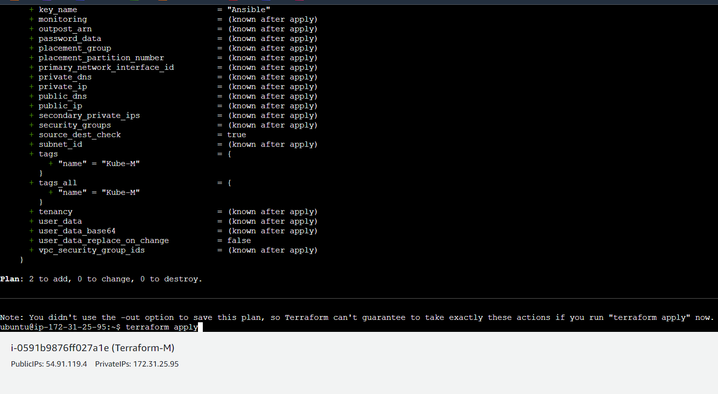
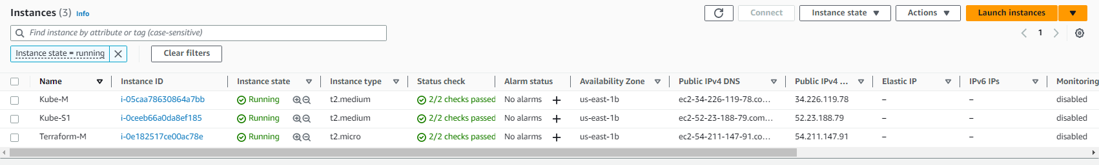
Step : 04
After creating main.tf and writing necessary code for launching the ec2 instance. We have to perform certain commands.
Terraform init : It is used to initialize your code to download the requirements mentioned in your code.
Terraform plan : It will check the changes and updation.
Terraform apply : In this command we accept the changes and will apply them.

Slide 6
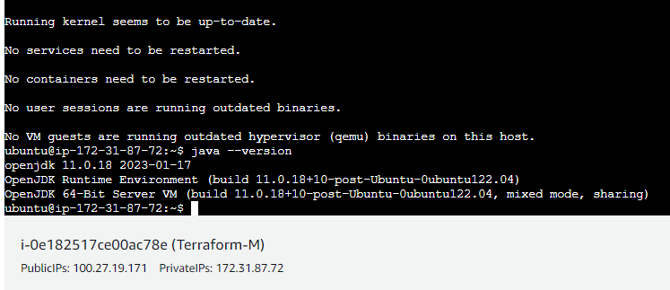
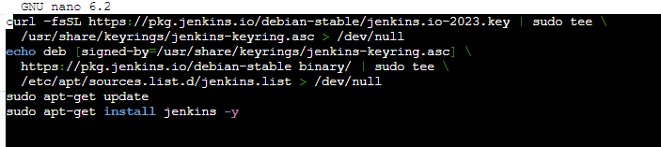
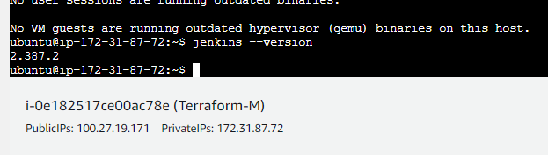
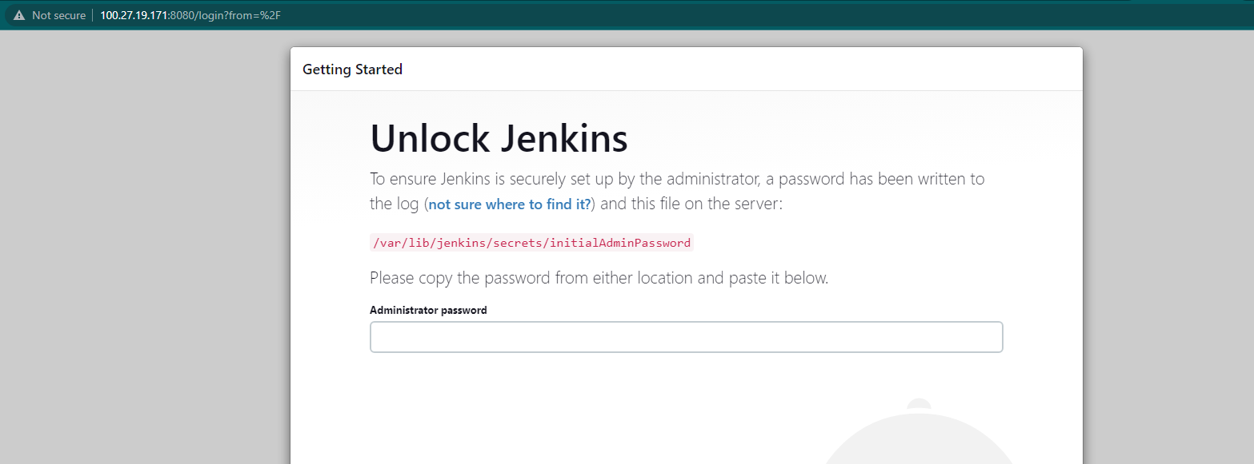
.
Step : 05
We have created the instance. Now we have to installation the Jenkins on Terraform master for installing Jenkins we have to install Java too. As the Jenkins is java based tool/software. As installation of Jenkins copy paste the public IP with port 8080.
After installation of Jenkins on Terraform-M, we have to install java on rest instances.

Slide 7
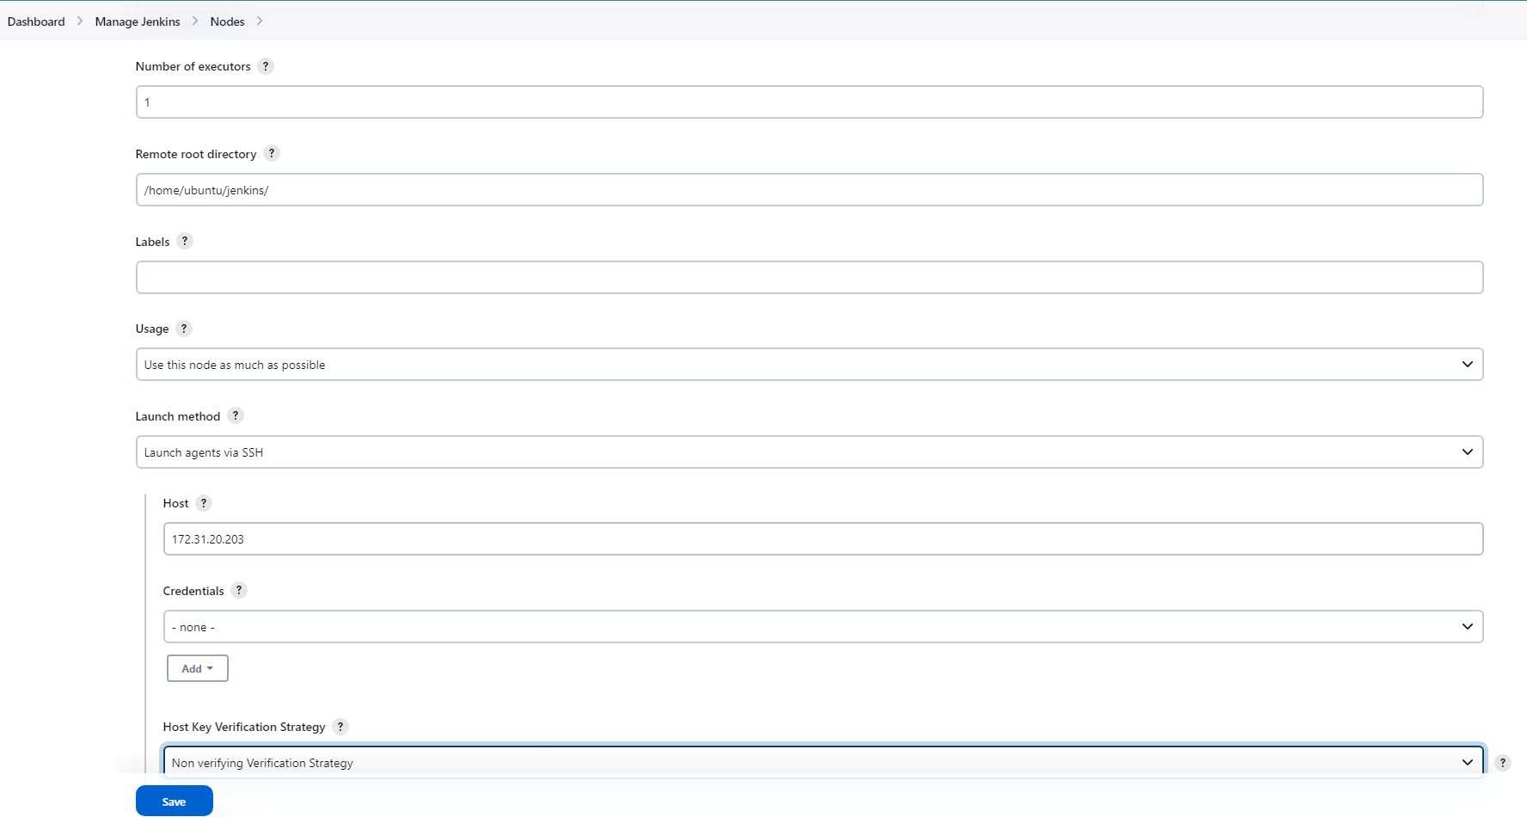
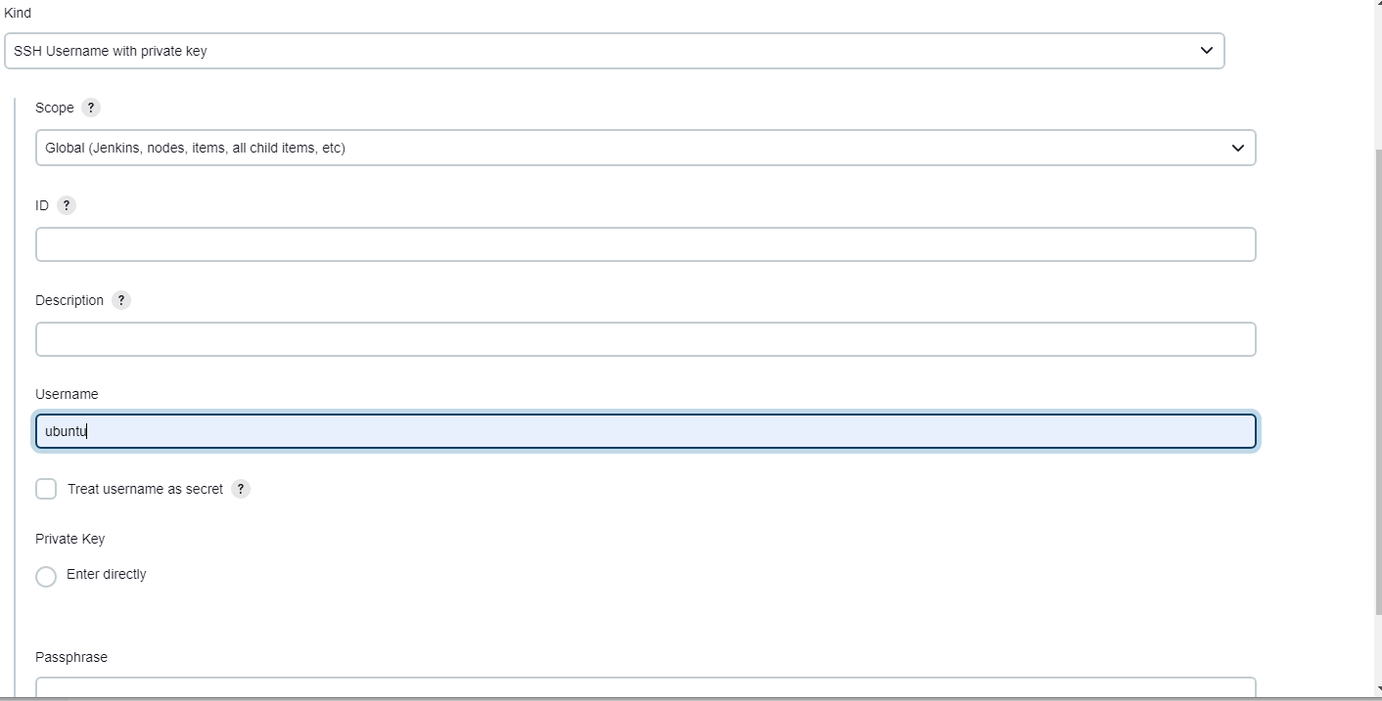
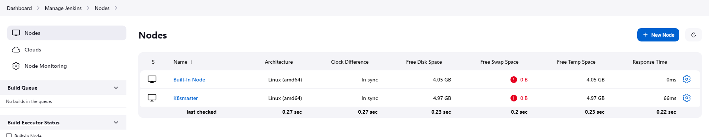
.
Step : 06
We have installed the Jenkins, Now we have to install necessary plugins and have to create the nodes. We have to fill the below parts.
Remote root directory : /home/ubuntu/jenkins/ Launch Method : Launch agent via SSH
Credentials : We have to add pem key contain here Host key verification strategy : Non verifying verification strategy

Slide 8
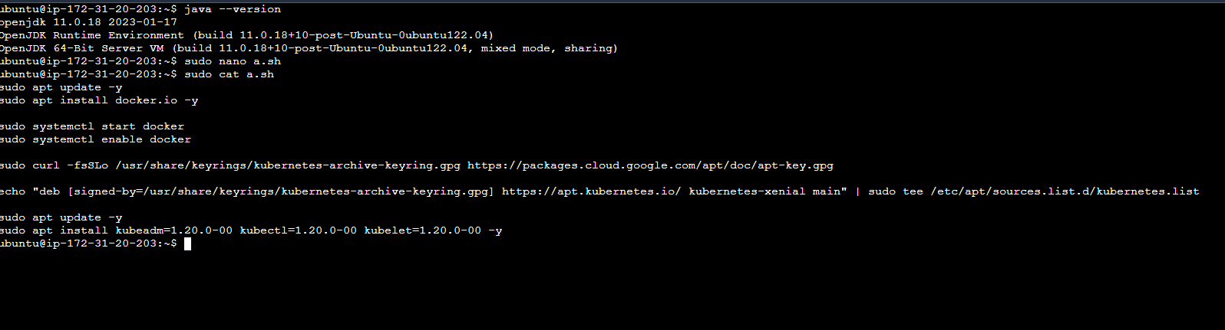
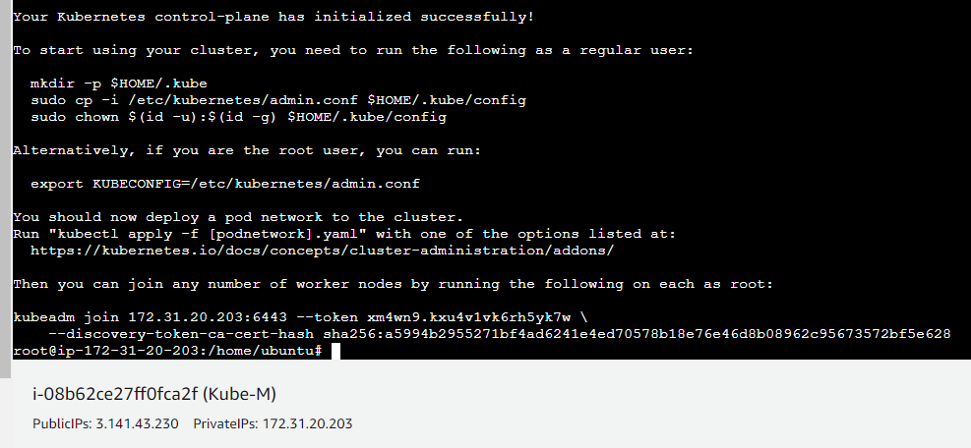
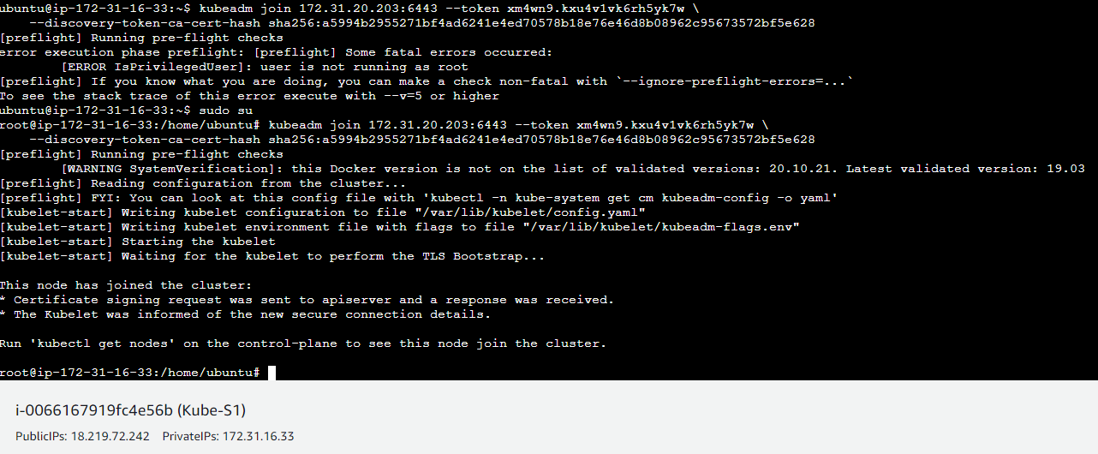
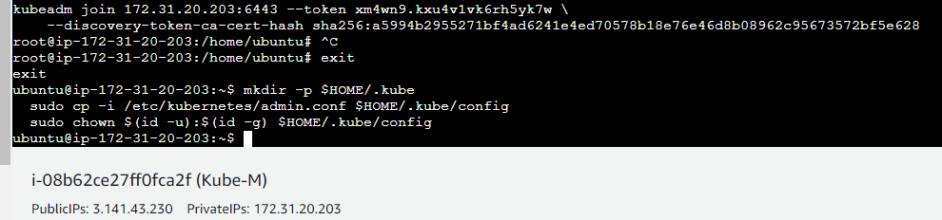
Step : 07
We have to install docker and Kubernetes on both Kube-M & Kube-S1. After installation run the command kubeadm init so that we will get kubeadm token which we have to paste at Kube-S1.
After installation check the nodes, use the command kubectl get nodes. In case if we get nodes not ready then use command kubectl apply -f https://github.com/weaveworks/weave/releases/download/v2.8.1/weave-daemonset-k8s.yaml.

Slide 9
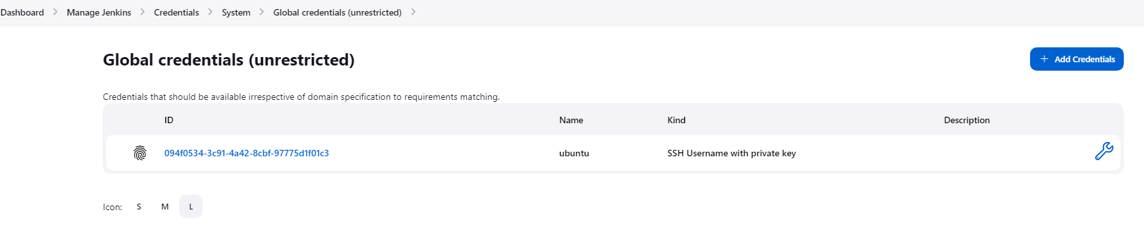
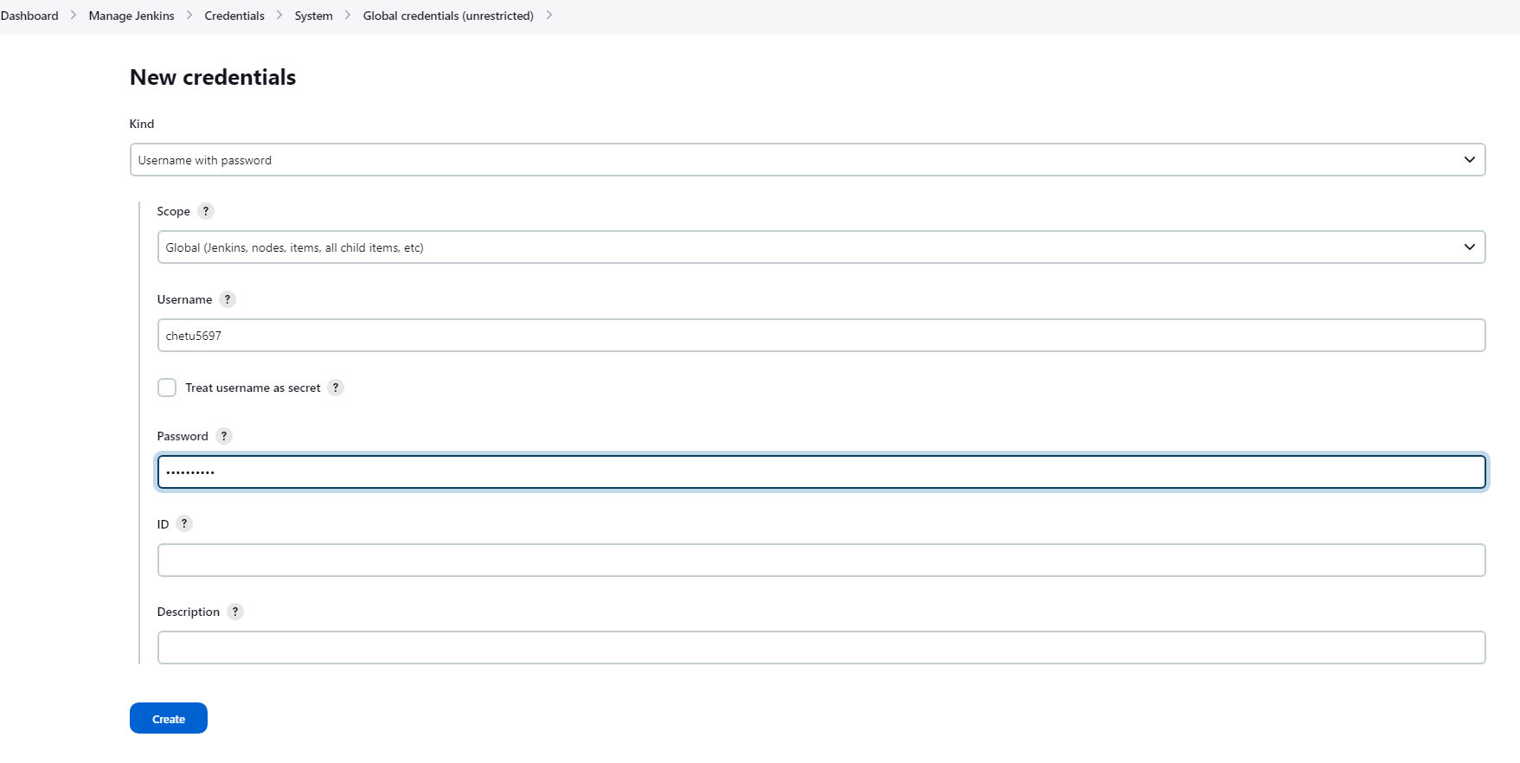
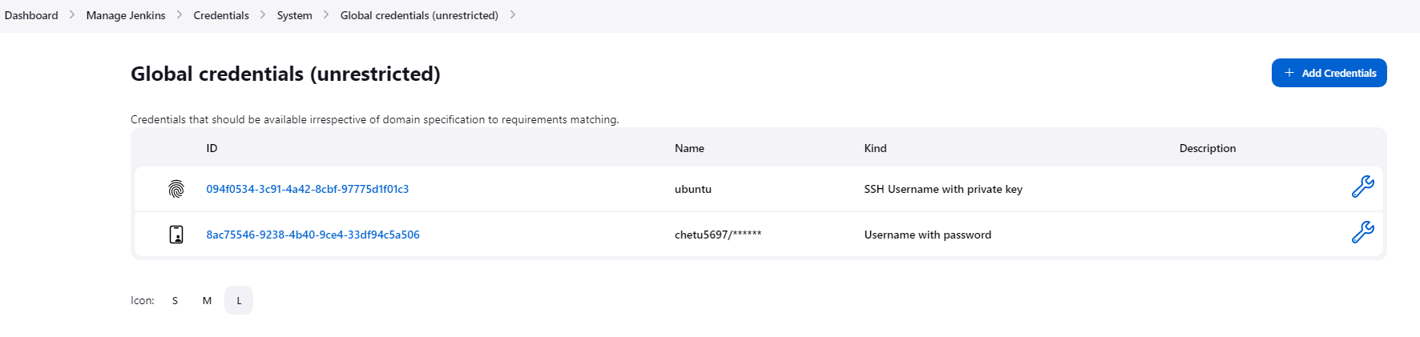
.
Step : 08
Create the credential for docker hub account in Jenkins credential. Fill the required details and save it. After saving it we will get one ID which we have to use in groovy script.

Slide 10
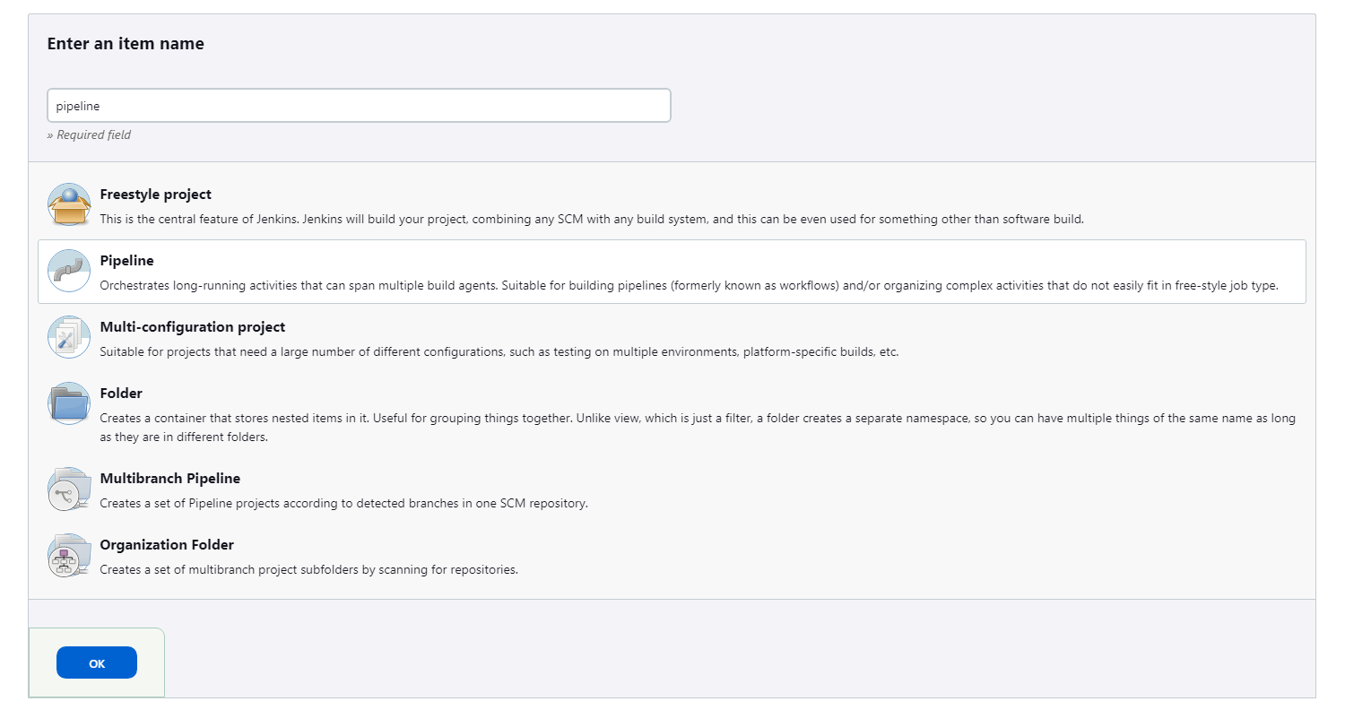
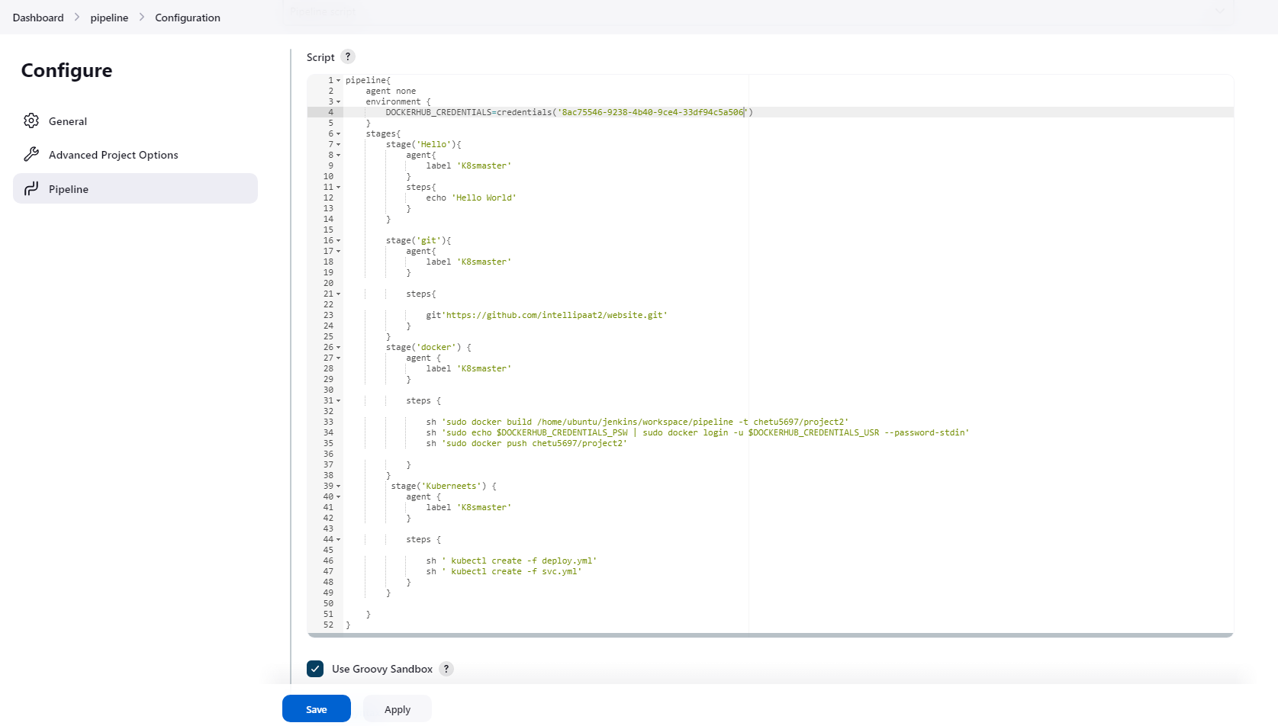
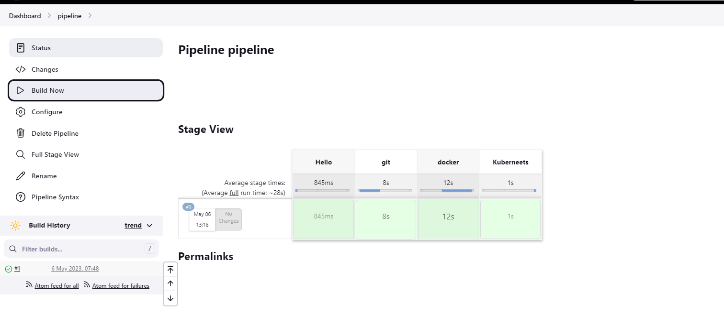
.
Step : 09
After all the configuration we have to create pipeline for the project.
We have to write Groovy script to perform the task. Post writing the script and running pipeline successfully.
Copy the Kube-S1 public IP and paste on new page for checking.

Slide 11
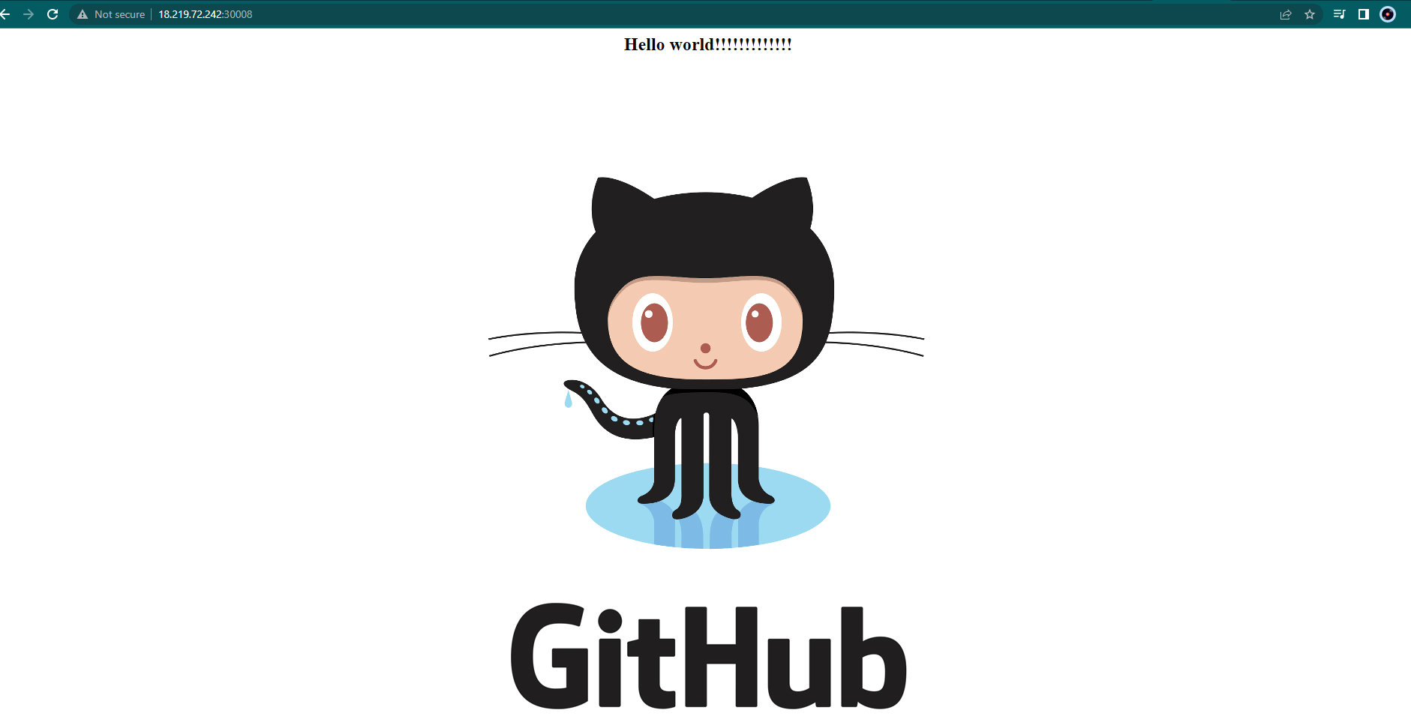
Finally copy pasted the public IP of Kube-S1 with port number 30008 as per the requirement.

